Slide 1

Exploration of Interhost Transmission of Highly Pathogenic H5N1 Avian Influenza in Egypt
K. Bodie Weedop
Bahl Lab Rotation

Slide 2
Exploration of the Phylodynamic Pipeline using Interhost Transmission of Highly Pathogenic H5N1 Avian Influenza in Egypt
K. Bodie Weedop
Bahl Lab Rotation

Slide 3
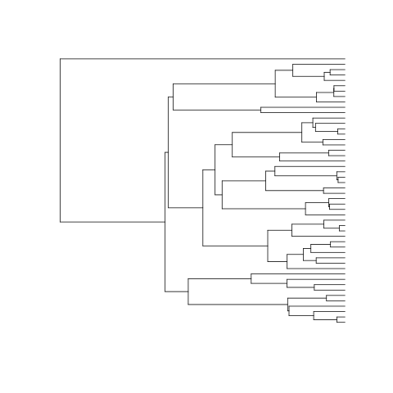
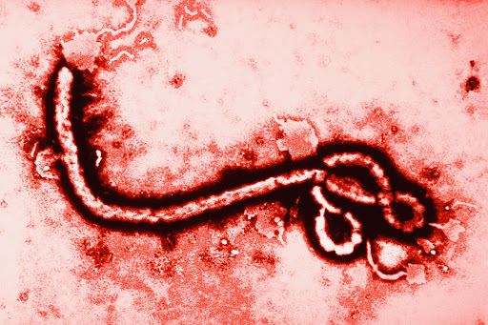


Slide 4


Slide 5




Slide 6
Overview
Brief summary of HP H5N1 in Egypt
Data Wrangling
Preliminary analysis with RAxML and tempEST
Taming the BEAST Pt. 2
Signal in the noise
Future Directions (Beginner Perspective)

Slide 7
Brief summary of HP H5N1 in Egypt
History
Guangdong in 1996 and Hong Kong in 1997; re-emergence in SE Asia was seen in 2003¹
Surveillance program started in Egypt and nothing detected until almost too late¹
Introduction was thought to be due to some legal or illegal trade of domestic poultry until the detection of (A/Teal/Egypt/14051-NAMRU3/2006) ¹
Egypt declared as HP H5N1 endemic country with a number of Asian countries²
Notes:
Abdelwhab, E.M. and Abdel-Moneim, A.S., 2015. Epidemiology, ecology and gene pool of influenza A virus in Egypt: will Egypt be the epicentre of the next influenza pandemic?. Virulence, 6(1), pp.6-18.
International Office of Epizootics, 2007. The global strategy for prevention and control of H5N1 highly pathogenic avian influenza. Food & Agriculture Org..

Slide 8
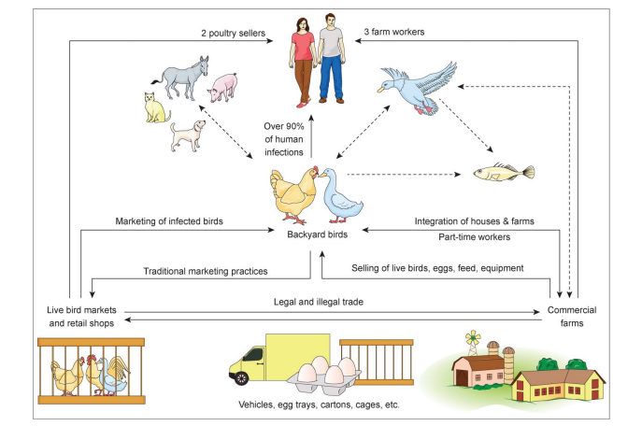
Brief summary of HP H5N1 in Egypt
Ecology
Abdelwhab & Abdel-Moneim 2015.

Slide 9
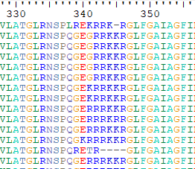
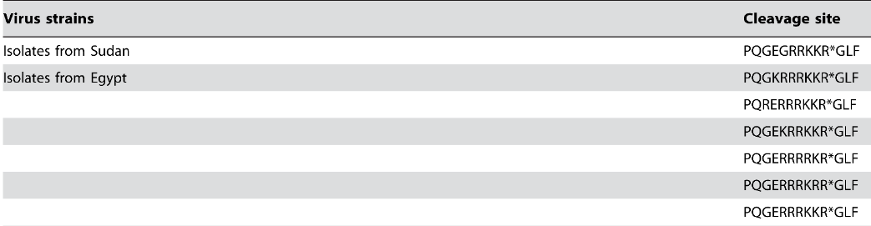
Brief summary of HP H5N1 in Egypt
Genetics and Epidemiology
High path vs. low path?
Basic AAs in HA cleavage site
Reassortant
Devastating in birds and humans (not usual)
Broad tissue tropism in birds
Low efficiency for human to human transmission
Cattoli et al. 2009

Slide 10
Brief summary of HP H5N1 in Egypt
Genetics and Epidemiology
High path vs. low path?
Basic AAs in HA cleavage site
Devastating in birds and humans (not usual)
Broad tissue tropism in birds
Low efficiency for human to human transmission
Concerns for drift and reassortment
Cattoli et al. 2009

Slide 11
Overview
Brief summary of HP H5N1 in Egypt
Data Wrangling
Preliminary analysis with RAxML and tempEST
Taming the BEAST Pt. 2
Signal in the noise
Future Directions (Beginner Perspective)

Slide 12
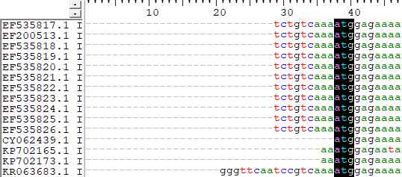
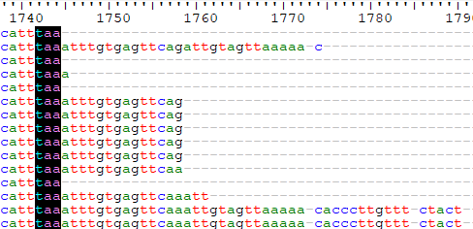
Data Wrangling
Metadata in labels
(CY126026.1|H5N1|HA|Avian|chicken|Egypt|Menofia|20091001)
MAFFT
BioEdit and alignment trimming

Slide 13
Data Wrangling
Metadata in labels
(CY126026.1|H5N1|HA|Avian|chicken|Egypt|Menofia|20091001)
MAFFT
BioEdit and alignment trimming
Delete
Delete

Slide 14
Overview
Brief summary of HP H5N1 in Egypt
Data Wrangling
Preliminary analysis with RAxML and tempEST
Taming the BEAST Pt. 2
Signal in the noise
Future Directions (Beginner Perspective)

Slide 15
Preliminary analysis with RAxML and tempEST
Problem: BEAST can be a large investment of time and computational resources

Slide 16
Preliminary analysis with RAxML and tempEST
Problem: BEAST can be a large investment of time and computational resources
Solution: RAxML and tempEST

Slide 17
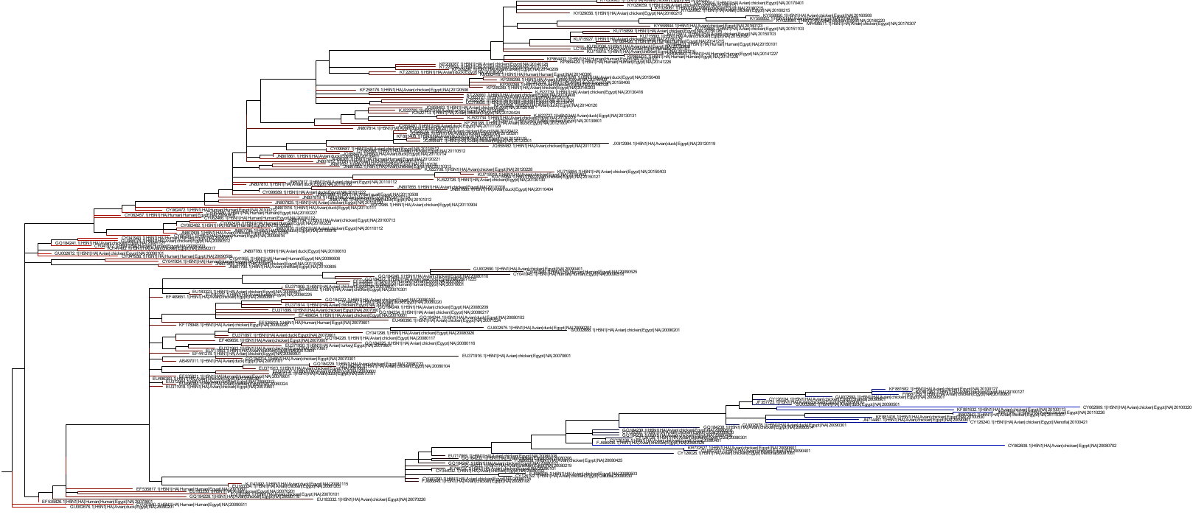
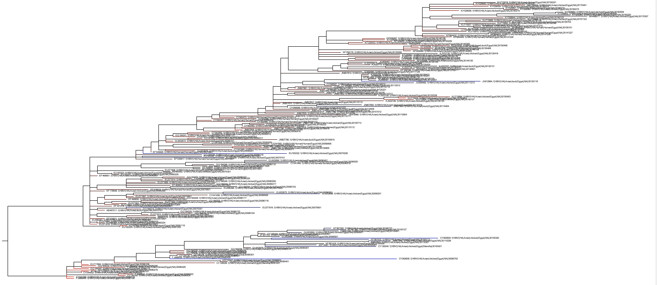
Preliminary analysis with RAxML and tempEST
RAxML and tempEST give us a quick and easy preliminary analysis.
RAxML gives us a single or set of maximum likelihood tree(s) and our first look at phylogenetic signal.
tempEST provides a sense of “clockliness” and temporal signal.

Slide 18
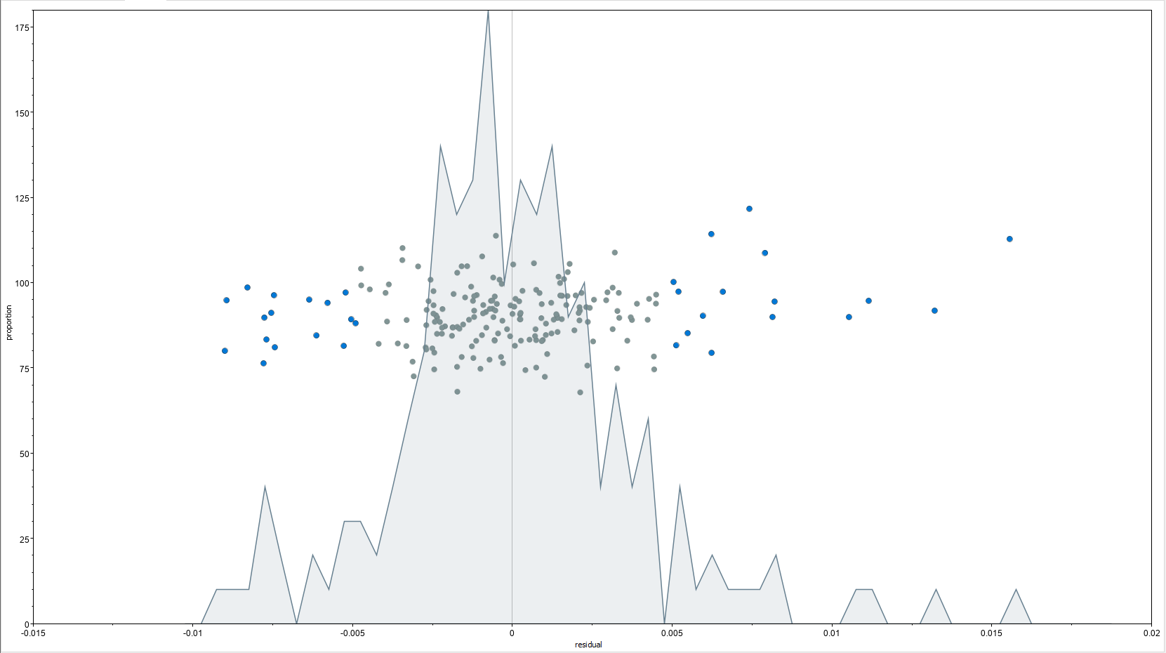
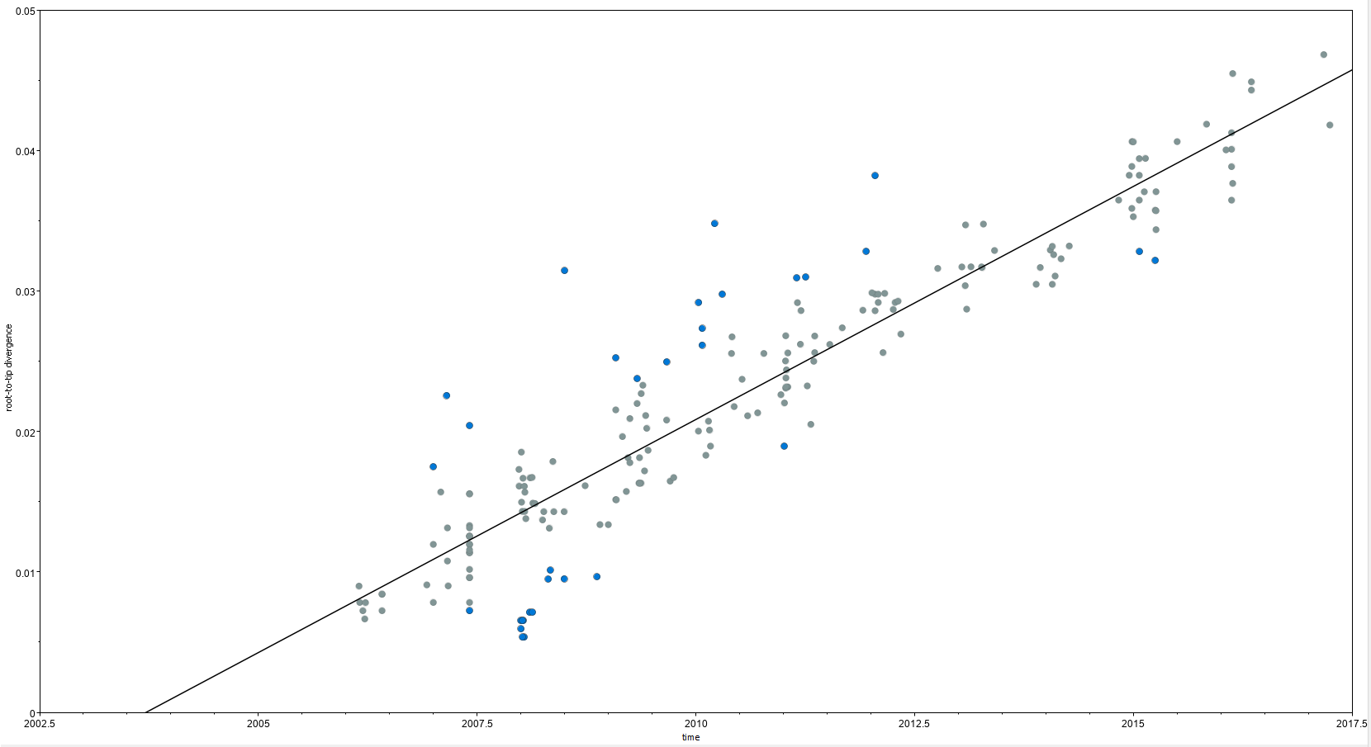
Preliminary analysis with RAxML and tempEST
Outliers

Slide 19
Overview
Brief summary of HP H5N1 in Egypt
Data Wrangling
Preliminary analysis with RAxML and tempEST
Taming the BEAST Pt. 2
Signal in the noise
Future Directions (Beginner Perspective)
You may be have to go back and forth between these steps.

Slide 20
Overview
Brief summary of HP H5N1 in Egypt
Data Wrangling
Preliminary analysis with RAxML and tempEST
Taming the BEAST Pt. 2
Signal in the noise
Future Directions (Beginner Perspective)

Slide 21
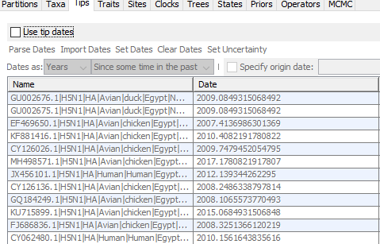
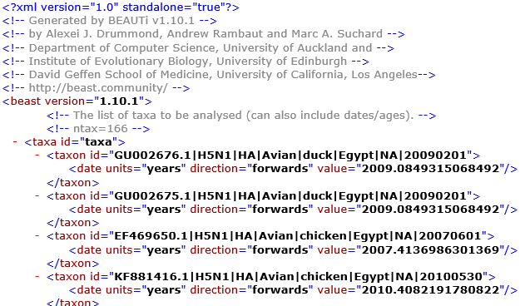
Taming the BEAST Pt. 2

Slide 22
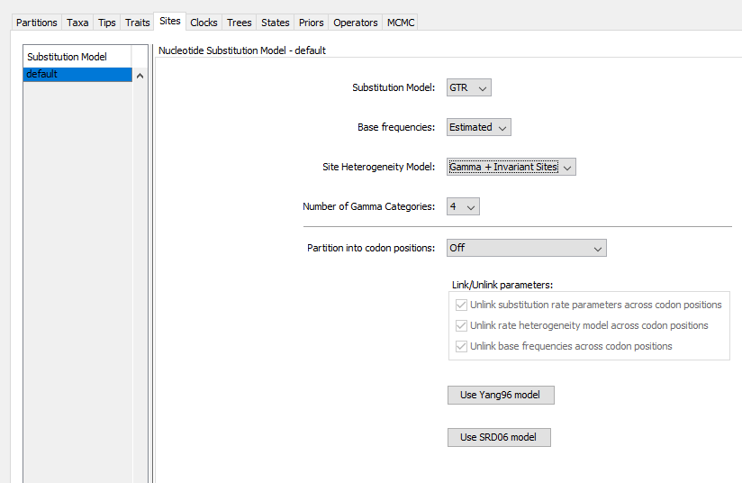
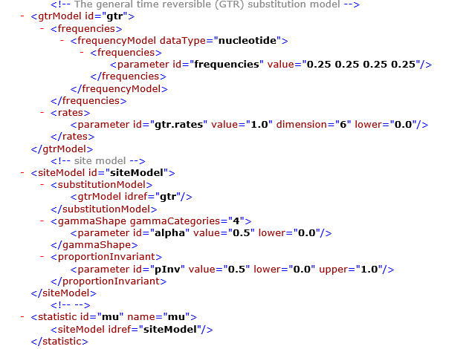
Taming the BEAST Pt. 2

Slide 23
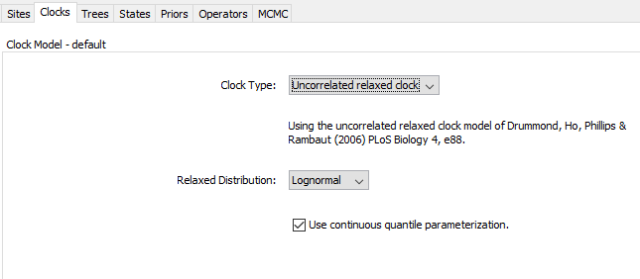
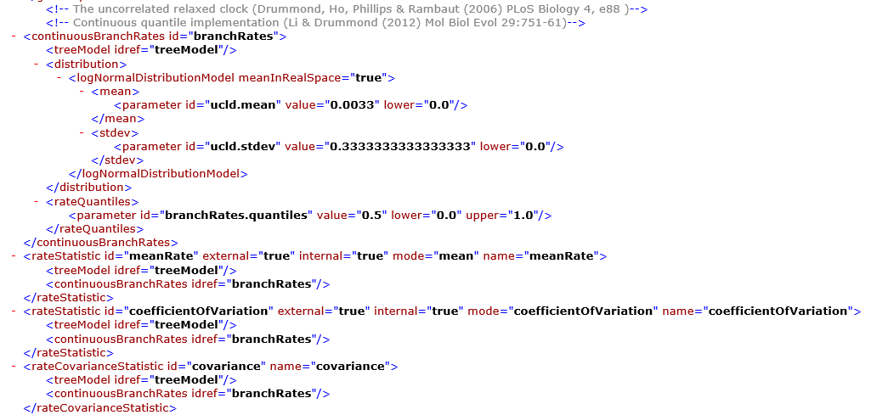
Taming the BEAST Pt. 2

Slide 24
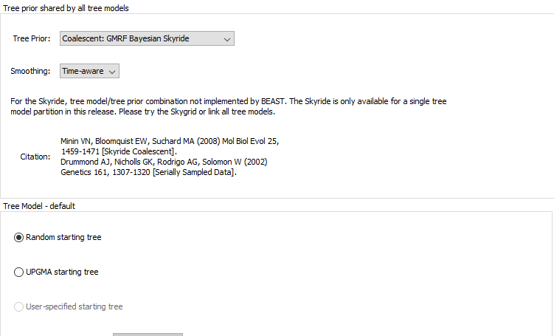
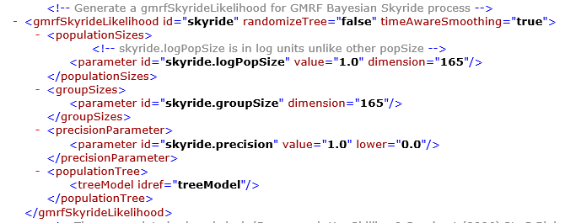
Taming the BEAST Pt. 2

Slide 25
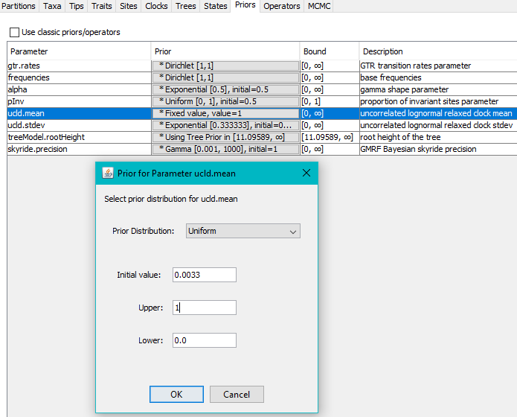
Taming the BEAST Pt. 2
Uncorrelated Lognormal Relaxed Clock Mean
0.0033?? A bit of magic that needs explaining?
Six runs

Slide 26
Overview
Brief summary of HP H5N1 in Egypt
Data Wrangling
Preliminary analysis with RAxML and
Taming the BEAST Pt. 2
Signal in the noise
Future Directions (Beginner’s Perspective)

Slide 27
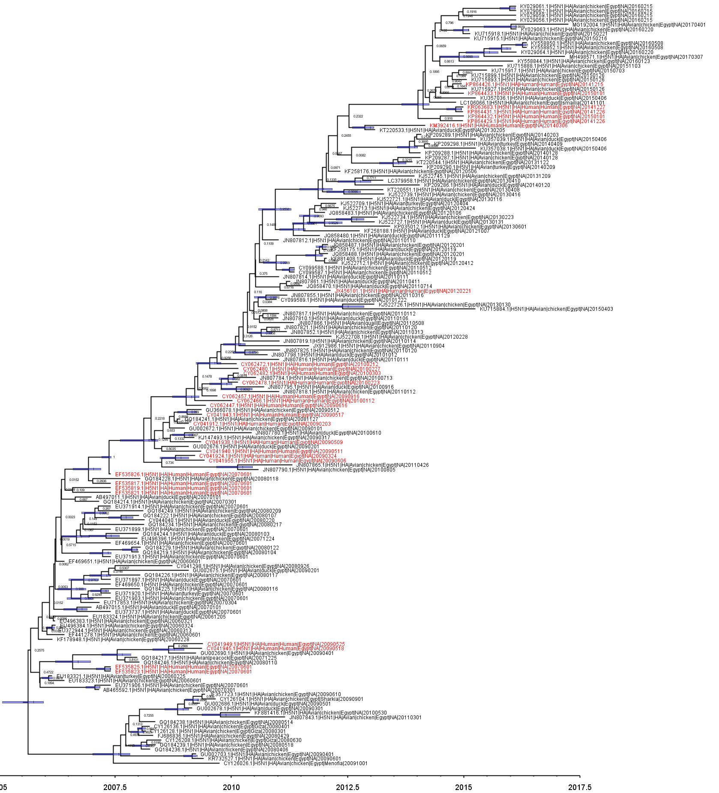
Humans in red
Humans all on the terminal branches
Egypt is a hotspot for pandemic. HPAIV H5N1 has potential to adapt to humans via antigenic drift.
Reassortment
Lessons learned:
Root?

Slide 28
Future Directions (Beginner’s Perspective)
Modeling of reassortment (triple reassortants)
Simulating data at multiple scales
SLiM-esque application (https://messerlab.org/slim/)
Evaluate our vaccination (prediction) models

Slide 29
Acknowledgements
Thank you to the Bahl Lab for accommodating me for rotation #1.
Special thanks to Lambo and Jiani who gave me more papers than I could read in a week.
Off to the Rohani Lab

Slide 30
Abdelwhab, E.M. and Abdel-Moneim, A.S., 2015. Epidemiology, ecology and gene pool of influenza A virus in Egypt: will Egypt be the epicentre of the next influenza pandemic?. Virulence, 6(1), pp.6-18.
International Office of Epizootics, 2007. The global strategy for prevention and control of H5N1 highly pathogenic avian influenza. Food & Agriculture Org..
Cattoli, G., Monne, I., Fusaro, A., Joannis, T.M., Lombin, L.H., Aly, M.M., Arafa, A.S., Sturm-Ramirez, K.M., Couacy-Hymann, E., Awuni, J.A. and Batawui, K.B., 2009. Highly pathogenic avian influenza virus subtype H5N1 in Africa: a comprehensive phylogenetic analysis and molecular characterization of isolates. PLoS One, 4(3), p.e4842.
Hoffmann, E., J. Stech, I. Leneva, S. Krauss, C. Scholtissek, P. S. Chin, M. Peiris, K. F. Shortridge, and R. G. Webster. 2000. Characterization of the influenza A virus gene pool in avian species in southern China: was H6N1 a derivative or a precursor of H5N1? J. Virol. 74:6309–6315.
Guan, Y., K. F. Shortridge, S. Krauss, and R. G. Webster. 1999. Molecular characterization of H9N2 influenza viruses: were they the donors of the “internal” genes of H5N1 viruses in Hong Kong? Proc. Natl. Acad. Sci. USA 16:9363–9367.
Xu, X., K. Subbarao, N. J. Cox, and Y. Guo. 1999. Genetic characterization of the pathogenic influenza A/goose/Guangdong/1/96 (H5N1) virus: similarity of its hemagglutinin gene to those of H5N1 viruses from the 1997 outbreaks in Hong Kong. Virology 261:15–19.

